Slide 1
Unicast Routing Protocols
Unicast communication : Communication between one sender and one receiver, a one-to-one communication.
Routers create their routing tables to support unicast communication.
Copyright © The McGraw-Hill Companies, Inc. Permission required for reproduction or display.

Slide 2
11-1 INTRODUCTION
An internet is a combination of networks connected by routers.
When a datagram goes from a source to a destination, it will probably pass through many routers until it reaches the router attached to the destination network.

Slide 3
11-1 INTRODUCTION
Cost or Metric
A router is usually attached to several networks. When it receives a packet, to which network should it pass the packet? The decision is based on optimization.
One approach is to assign a cost for passing through a network. call this cost or metric.
High cost can be thought of as something bad;
If we want to minimize the delay, low delay is low cost and high delay is high cost

Slide 4
11-1 INTRODUCTION
Static versus Dynamic Routing Tables
A routing table can be either static or dynamic.
A static table is one with manual entries.
A dynamic table, is one that is updated automatically when there is a change somewhere in the internet.
They need to be updated when a link is down, and they need to be updated whenever a better route has been found.

Slide 5
11-1 INTRODUCTION
Routing Protocol
Routing protocols are created in response to the demand for dynamic routing tables.
A routing protocol is a combination of rules and procedures that lets routers in the internet inform each other of changes.
It allows routers to share whatever they know about the internet or their neighborhood.
The routing protocols also include procedures for combining information received from other routers.

Slide 6
11-2 INTER- AND INTRA-DOMAIN ROUTING
Internet is so large that one routing protocol cannot handle the task of updating the routing tables of all routers.
Internet is divided into autonomous systems.
Autonomous system (AS) : Group of networks and routers under the authority of a single administration.
Intra-domain routing : Routing inside an autonomous system.
Inter-domain routing : Routing between autonomous systems.

Slide 7
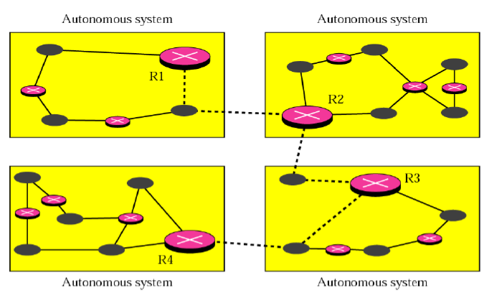
Figure 11.1 Autonomous systems
Each autonomous system can choose one or more intradomain routing protocols.
Only one interdomain routing protocol for routing between autonomous systems.

Slide 8
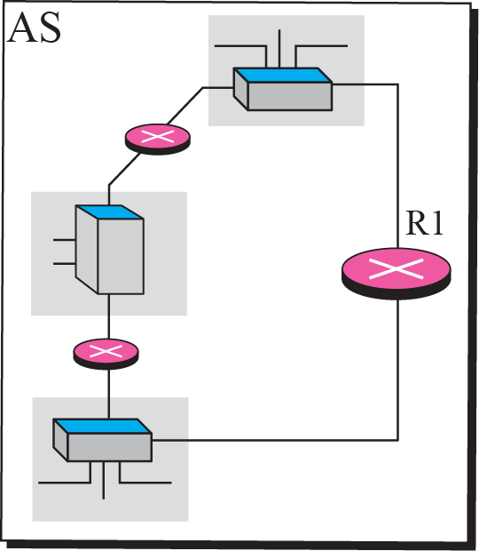
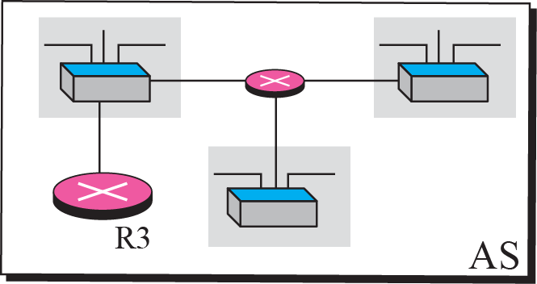
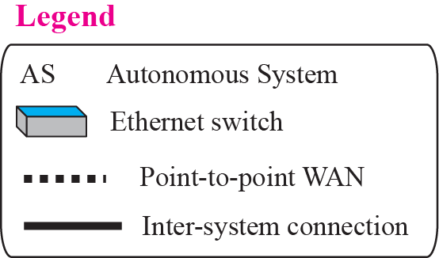
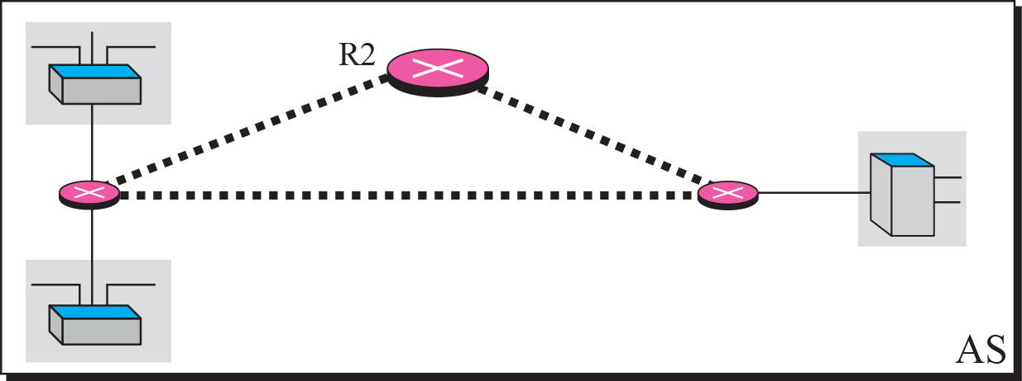
Figure 11.1 Autonomous systems

Slide 9
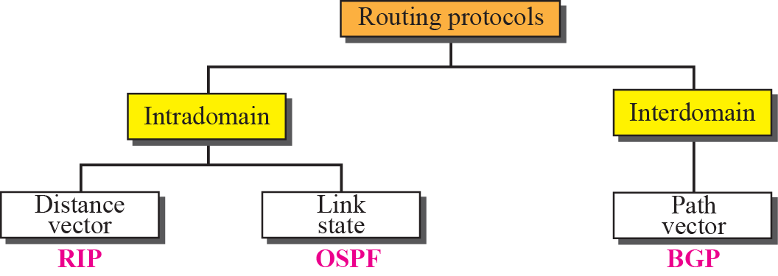
Figure 11.2 Popular routing protocols
Several intra-domain and inter-domain routing protocols are in use.
Routing Information Protocol (RIP) is the implementation of the distance vector routing.
Open Shortest Path First (OSPF) is the implementation of the link state routing.
Border Gateway Protocol (BGP) is the implementation of the path vector routing.

Slide 10
11-3 DISTANCE VECTOR ROUTING
This method sees an AS, with all routers and networks, as a graph, a set of nodes and lines (edges) connecting the nodes.
A router can normally be represented by a node and a network by a link connecting two nodes.
Bellman-Ford algorithm (Ford-Fulkerson) to find the shortest path between nodes in a graph.

Slide 11
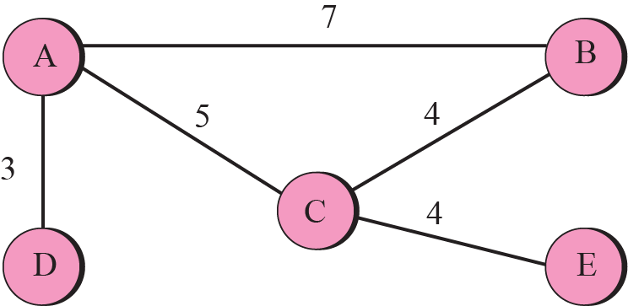
Bellman-Ford algorithm
If we know the cost between each pair of nodes, we can use the algorithm to find the least cost (shortest path) between any two nodes.

Slide 12
Bellman-Ford algorithm
Basic idea : if all neighbors of node i know the shortest distance to node j, then the shortest distance between node i and j can be found by adding the distance between node i and each neighbor to the neighbor’s shortest distance to node j and then select the minimum.

Slide 13
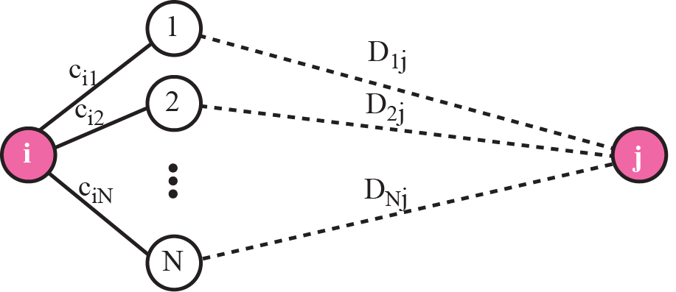
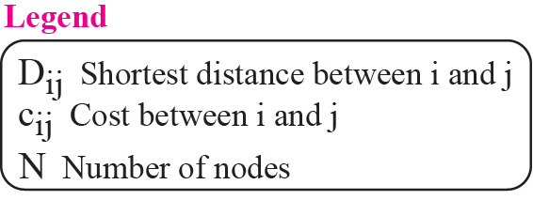
Figure 11.4 The fact behind Bellman-Ford algorithm

Slide 14
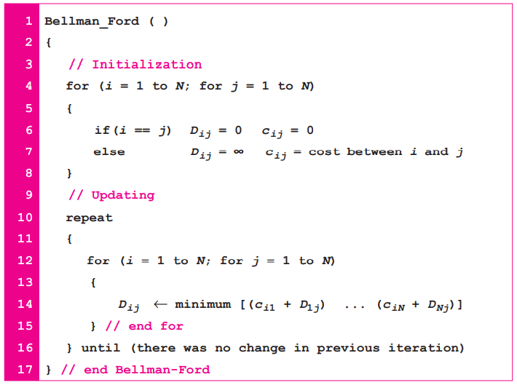
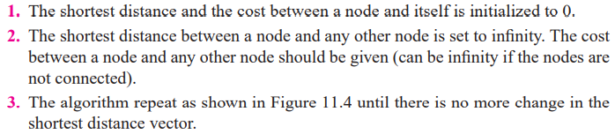

Slide 15
Figure 11.2 Popular routing protocols
Routing Information Protocol (RIP)
Open Shortest Path First (OSPF)
Border Gateway Protocol (BGP)

Slide 16
Distance Vector Routing Algorithm
To use the algorithm for creating the routing table for routers in an AS, we need to change the algorithm:
In distance vector routing, the cost is normally hop counts. The cost between any two neighbors is set to 1.
Each router needs to update its routing table asynchronously, whenever it has received some information from its neighbors. Each router executes part of the whole algorithm. Processing is distributive.
After a router has updated its routing table, it should send the result to its neighbors so that they can also update their routing table.
4. Each router should keep at least three pieces of information for each route: destination network, the cost, and the next hop.
Refer the whole routing table as Table, to the row i in the table as Table_{i}, to the three columns in row i as Table_{i} .dest, Table_{i} .cost, and Table_{i} .next.
5. Refer to information about each route received from a neighbor as R (record), which has only two pieces of information: R.dest and R.cost.
The next hop is not included in the received record because it is the source address of the sender.

Slide 17
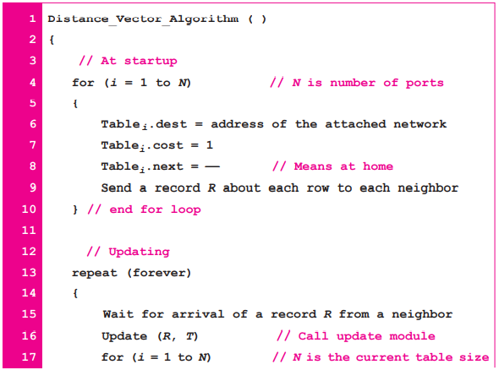
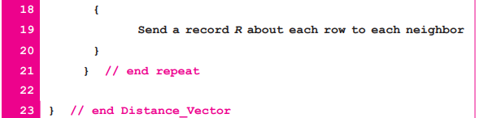
Distance Vector Routing Algorithm

Slide 18
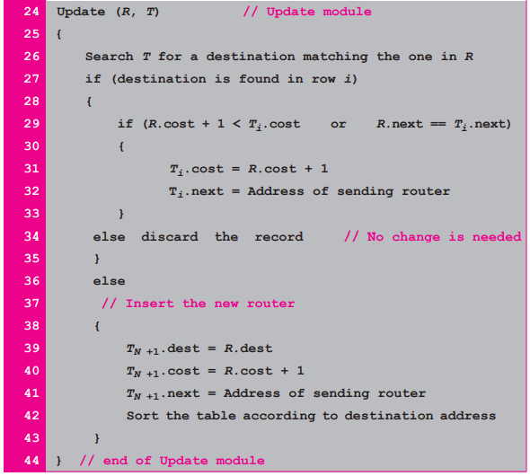
Distance Vector Routing Algorithm

Slide 19
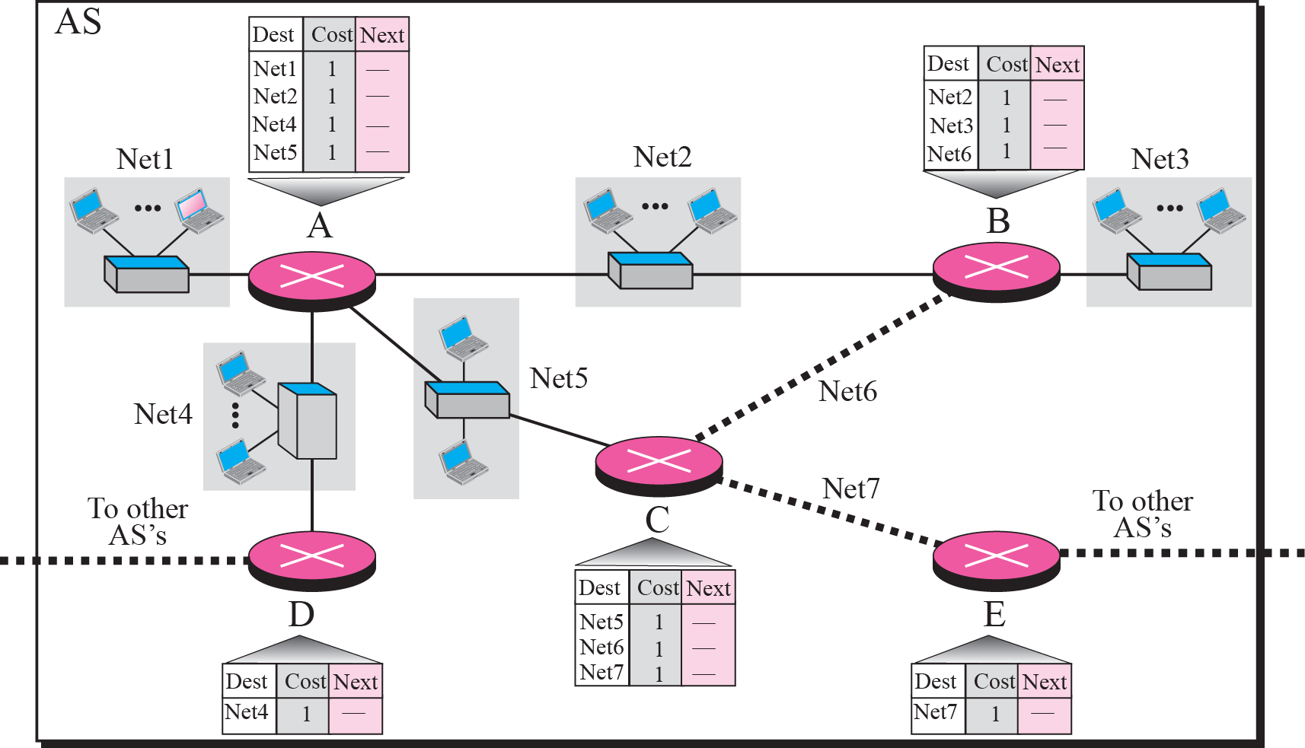
Figure 11.5 Example 11.1

Slide 20
Example 11.1
Figure 11.5 shows the initial routing table for an AS.
Each router creates its own routing table when it is booted.

Slide 21
Example 11.2
Assume router A sends four records to its neighbors, routers B, D, and C.
Figure shows the changes in B’s routing table when it receives these records.

Slide 22
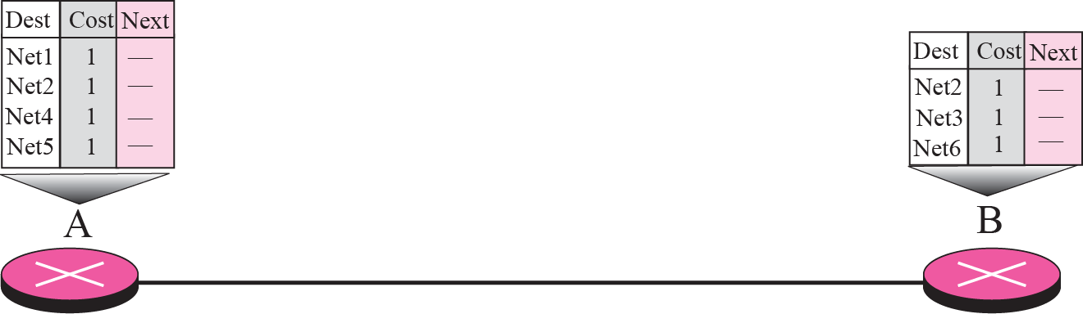

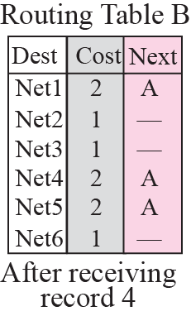
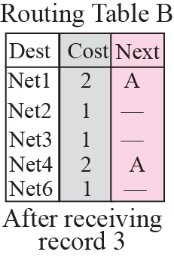
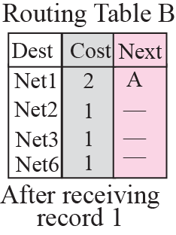
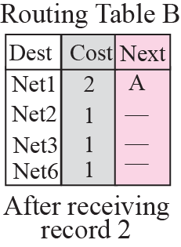
Figure 11.6 Example 11.2

Slide 23
Now router B has more information, but it is not complete. Router B does not even know that net7 exists. More updating is required.

Slide 24
Example 11.3
Figure 11.7 shows the final routing tables for routers in Figure 11.5.

Slide 25
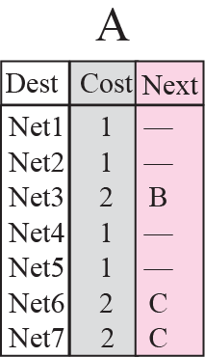
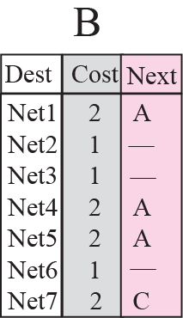
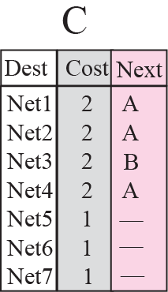
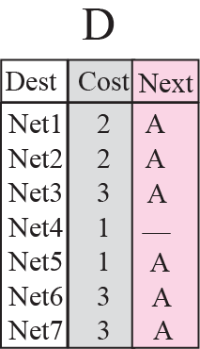
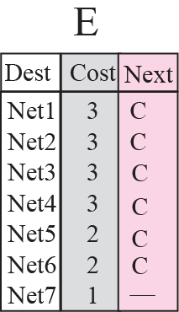
Figure 11.7 Example 11.3

Slide 26
Count to Infinity
A problem with distance vector routing is that any decrease in cost propagates quickly, but any increase in cost (bad news) propagates slowly.
Iif a link is broken (cost becomes infinity), every other router should be aware of it immediately, but in distance vector routing, this takes some time.
The problem is referred to as count to infinity.
It takes several updates before the cost for a broken link is recorded as infinity by all routers.
Two-Node Loop : One example of count to infinity is the two-node loop problem.

Slide 27
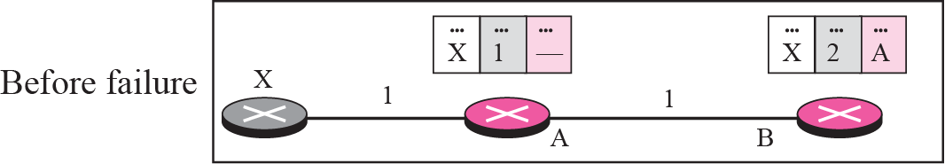
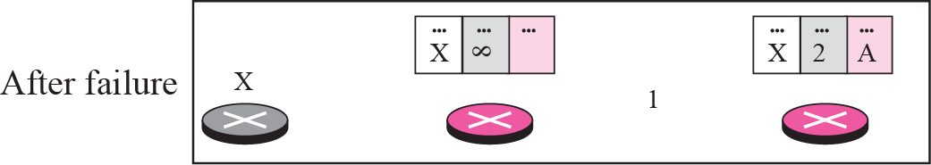
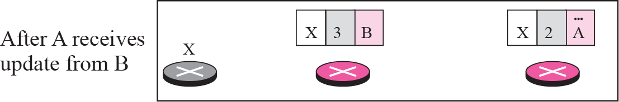
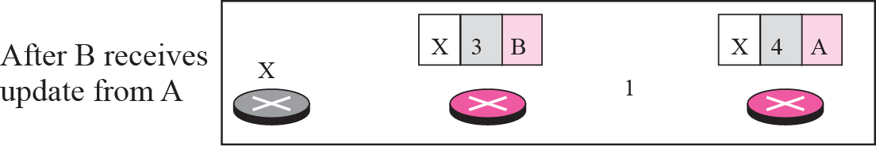
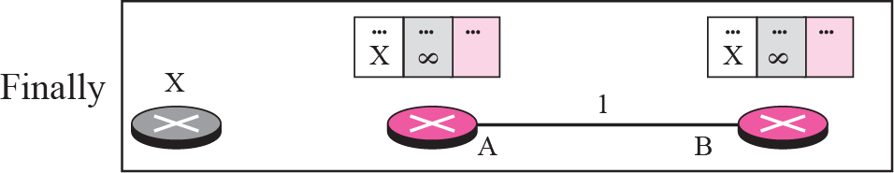
Figure 11.8 Two-node instability
Node A thinks that the route to X is via B; node B thinks that the route to X is via A.

Slide 28
If A receives a packet destined for X, it goes to B and then comes back to A.
Similarly, if B receives a packet destined for X, it goes to A and comes back to B.
Packets bounce between A and B, creating a two-node loop problem.
A few solutions have been proposed for instability of this kind.

Slide 29
Defining Infinity
First obvious solution is to redefine infinity to a smaller number, such as 16.
The system will be stable in fewer updates. Most implementations of the Distance Vector Protocol define 16 as infinity.
This means that distance vector cannot be used in large systems.
The size of the network, in each direction, can not exceed 15 hops.

Slide 30

Split Horizon
Another solution is called split horizon.
In this strategy, instead of flooding the table through each interface, each node sends only part of its table through each interface.
Here, node B eliminates the last line of its routing table before it sends it to A.
In this case, node A keeps the value of infinity as the distance to X.
Later, when node A sends its routing table to B, node B also corrects its routing table.
The system becomes stable after the first update: both node A and B know that X is not reachable.

Slide 31
Split Horizon and Poison Reverse
Using the split horizon strategy has one drawback.
Normally, the Distance Vector Protocol uses a timer, and if there is no news about a route, the node deletes the route from its table.
The split horizon strategy can be combined with the poison reverse strategy.
Node B can still advertise the value for X, but if the source of information is A, it can replace the distance with infinity as a warning: “Do not use this value; what I know about this route comes from you.”

Slide 32
Three-Node Instability
The two-node instability can be avoided using split horizon combined with poison reverse.
However, if the instability is between three nodes, stability cannot be guaranteed.

Slide 33
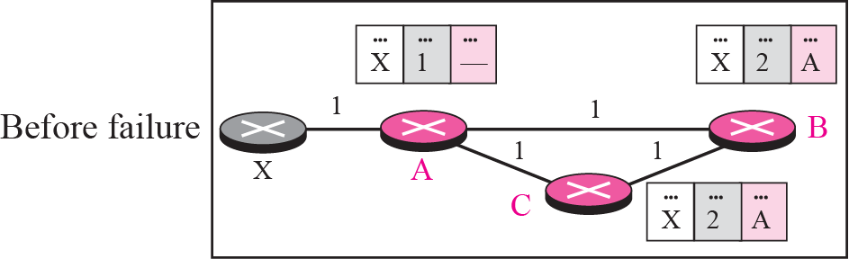
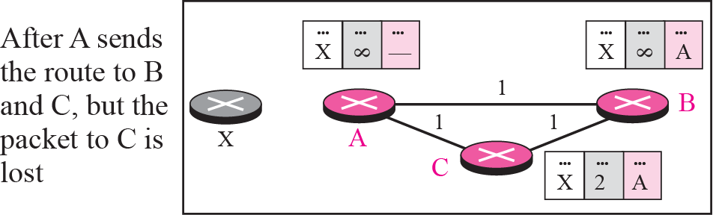
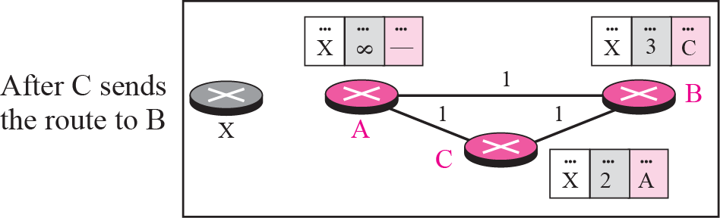
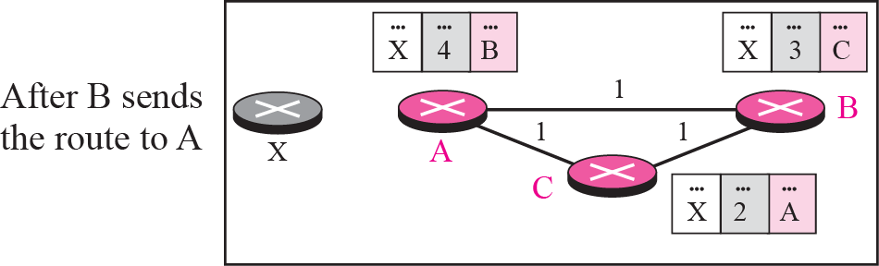
Figure 11.9 Three-node instability
If the instability is btw three nodes, stability cannot be guaranteed
Update loop until infinity

Slide 34
Figure 11.9 Three-node instability
The loop continues;
now A advertises the route to X to C, with increased cost, but not to B.
C then advertises the route to B with an increased cost.
B does the same to A. And so on.
The loop stops when the cost in each node reaches infinity.

Slide 35
11-4 RIP
The Routing Information Protocol (RIP) is an intra-domain (interior) routing protocol used inside an autonomous system.
It is a very simple protocol based on distance vector routing.
RIP implements distance vector routing directly with some considerations.

Slide 36
11-4 RIP
In an autonomous system, we are dealing with routers and networks (links), what was described as a node.
The destination in a routing table is a network, which means the first column defines a network address.
The metric used by RIP is very simple; the distance is defined as the number of links (networks) that have to be used to reach the destination. For this reason, the metric in RIP is called a hop count.
Infinity is defined as 16, which means that any route in an autonomous system using RIP cannot have more than 15 hops.
The next node column defines the address of the router to which the packet is to be sent to reach its destination

Slide 37
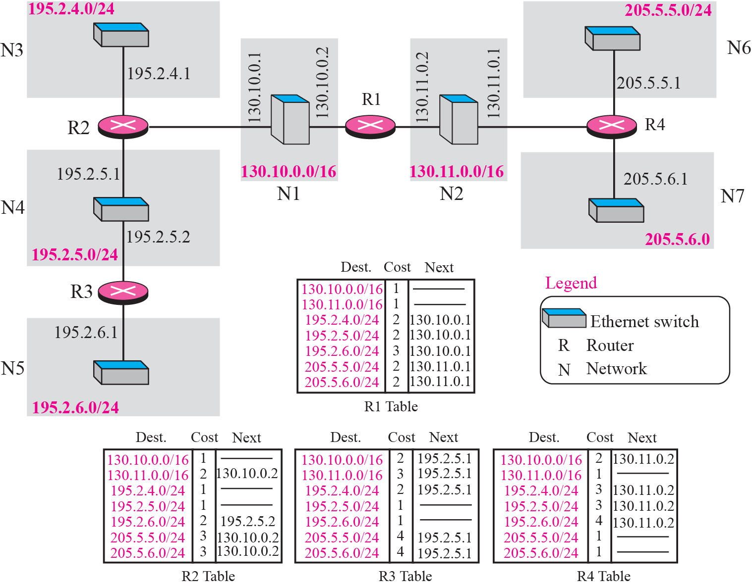
Figure 11.10 Example of a domain using RIP

Slide 38
Figure 11.10 Example of a domain using RIP

Slide 39
Figure 11.10 Example of a domain using RIP

Slide 40
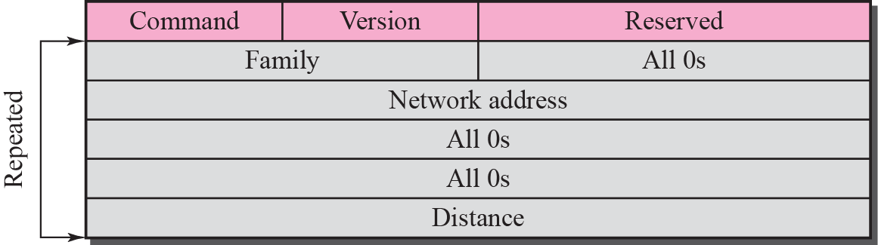
RIP Message Format
Command. 8-bit field specifies the type of message: request (1) or response (2).
Version. 8-bit field defines the version. Here used version 1, (version 2 has new features)
Family. 16-bit field defines the family of the protocol used. For TCP/IP the value is 2.
Network address. Defines the address of the destination network. RIP has allocated 14 bytes for this field to be applicable to any protocol. IP currently uses only 4 bytes. The rest of the address is filled with 0s.
Distance. 32-bit field defines the hop count (cost) from the advertising router to the destination network.

Slide 41
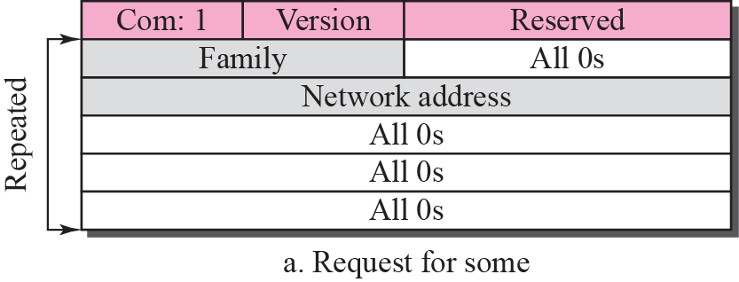
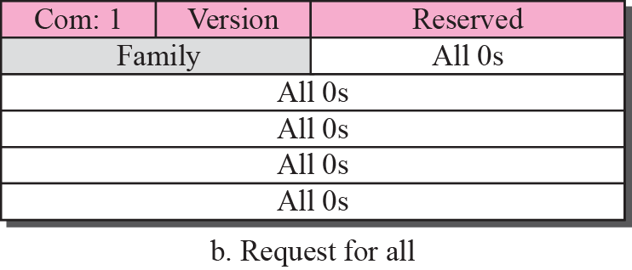
Requests and Responses
RIP has two types of messages: request and response
Request
A request message is sent by a router that has just come up or by a router that has some time-out entries.
A request can ask about specific entries or all entries
Figure Request messages

Slide 42
Requests and Responses
Response
A response can be either solicited or unsolicited.
A solicited response is sent only in answer to a request. It contains information about the destination specified in the corresponding request.
An unsolicited response, is sent periodically, every 30 seconds or when there is a change in the routing table.
The response is sometimes called an update packet.

Slide 43
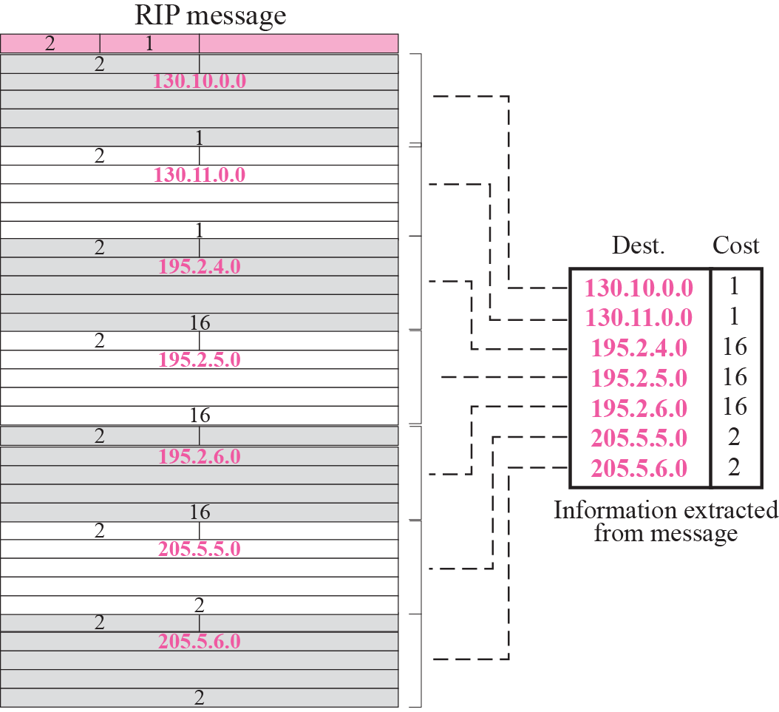
Figure 11.13 Solution to Example 11.4
Figure 11.13 shows the update message sent from router R1 to router R2 in Figure 11.10. The message is sent out of interface 130.10.0.2.

Slide 44
Figure 11.13 Solution to Example 11.4
Message is prepared with the combination of split horizon and poison reverse strategy in mind.
Router R1 has obtained information about networks 195.2.4.0, 195.2.5.0, and 195.2.6.0 from router R2.
When R1 sends an update message to R2, it replaces the actual value of the hop counts for these three networks with 16 (infinity) to prevent any confusion for R2.

Slide 45
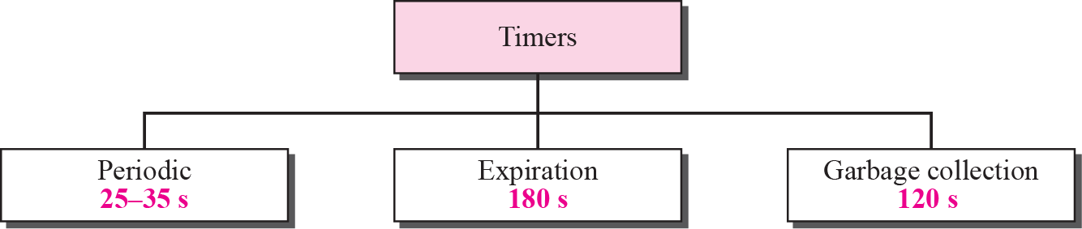
Figure 11.14 RIP timers
Timers in RIP
RIP uses three timers to support its operation.
periodic timer → controls the sending of messages,
expiration timer → governs the validity of a route,
garbage collection timer → advertises the failure of a route.

Slide 46
Periodic Timer
Controls the advertising of regular update messages.
Although the protocol specifies that this timer must be set to 30 s, the working model uses a random number between 25 and 35 s.
This is to prevent any possible synchronization and therefore overload on an internet if routers update simultaneously.

Slide 47
Expiration Timer
The expiration timer governs the validity of a route.
When a router receives update information for a route, the expiration timer is set to 180 s for that particular route.
Every time a new update for the route is received, the timer is reset.
If there is a problem and no update is received within the allotted 180 s, the route is considered expired and the hop count is set to 16.
Every route has its own expiration timer.

Slide 48
Garbage Collection Timer
When the information about a route becomes invalid, the router does not immediately purge that route from its table.
Instead, it continues to advertise the route with a metric value of 16.
At the same time, a timer called the garbage collection timer is set to 120 s for that route.
When the count reaches zero, the route is purged from the table.
This timer allows neighbors to become aware of the invalidity of a route prior to purging.

Slide 49
Example 11.5
A routing table has 20 entries. It does not receive information about five routes for 200 s. How many timers are running at this time?
Solution
The 21 timers are listed below:
Periodic timer: 1
Expiration timer: 20 − 5 = 15
Garbage collection timer: 5

Slide 50
RIP Version 2
Replaced those fields in version 1 that were filled with 0s for the TCP/IP protocol with some new fields.

Slide 51
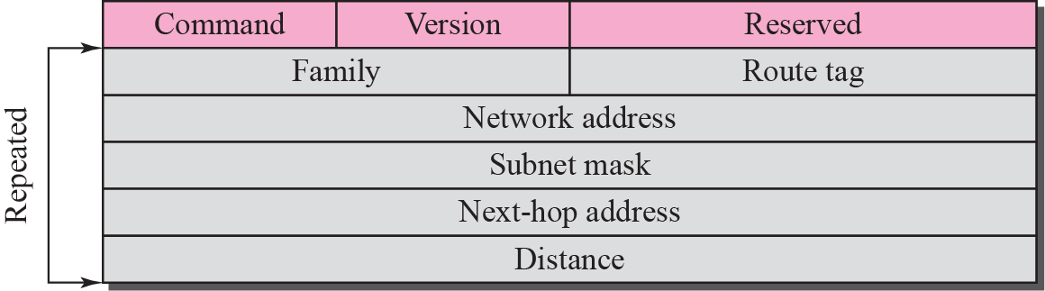
Figure 11.15 RIP version 2 format
The new fields of this message are :
Route tag. Carries information such as the autonomous system number. Used to enable RIP to receive information from an interdomain routing protocol.
Subnet mask. This is a 4-byte field that carries the subnet mask (or prefix). RIP2 supports classless addressing and CIDR.
Next-hop address. This field shows the address of the next hop.

Slide 52
Classless Addressing
Most important difference between the two versions of RIP is classful versus classless addressing.
RIPv1 uses classful addressing. The only entry in the message format is the network address (with a default mask).
RIPv2 adds one field for the subnet mask, which can be used to define a network prefix length.

Slide 53
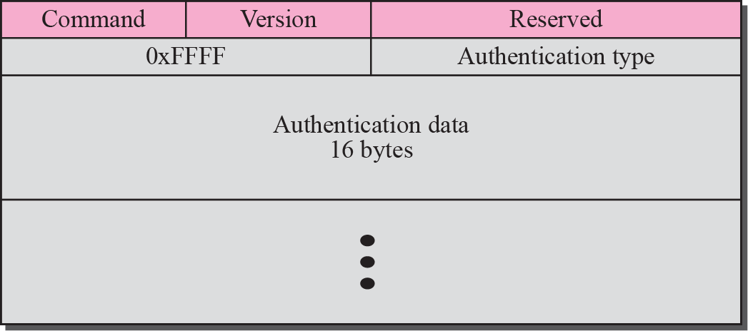
Authentication
Authentication is added to protect the message against unauthorized advertisement.
No new fields are added to the packet; instead, the first entry of the message is set aside for authentication information.
To indicate that the entry is authentication information and not routing information, the value of FFFF₁₆ is entered in the family field .
The second field, the authentication type, defines the protocol used for authentication, and the third field contains the actual authentication data.

Slide 54
Multicasting
Version 1 of RIP uses broadcasting to send RIP messages to every neighbor. All the routers on the network receive the packets, as well as the hosts.
RIP version 2, uses the all-router multicast address to send the RIP messages only to RIP routers in the network.
Encapsulation
RIP messages are encapsulated in UDP user datagrams.
A RIP message does not include a field that indicates the length of the message.
This can be determined from the UDP packet.
The well-known port assigned to RIP in UDP is port 520.

Slide 55
11-5 LINK STATE ROUTING
In link state routing, each node in the domain has the entire topology of the domain—the list of nodes and links, how they are connected including the type, cost (metric), and the condition of the links (up or down).
The node can use the Dijkstra algorithm to build a routing table.

Slide 56
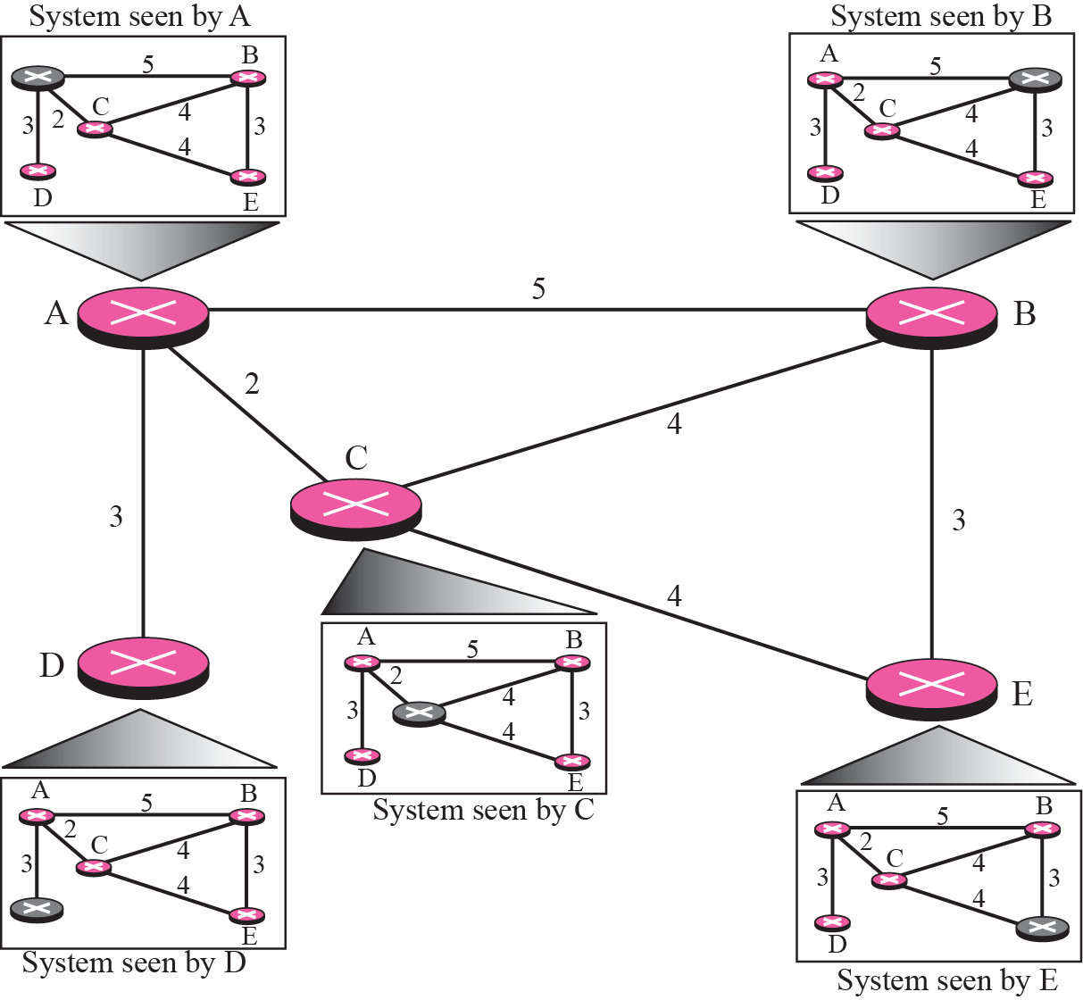
Figure 11.17 Concept of Link state routing

Slide 57
Figure 11.17 Concept of Link state routing
How can a common topology be dynamic and stored in each node?
No node can know the topology at the beginning or after a change somewhere in the network.
Link state routing is based on the assumption that, although the global knowledge about the topology is not clear, each node has partial knowledge: it knows the state (type, condition, and cost) of its links.
In other words, the whole topology can be compiled from the partial knowledge of each node.

Slide 58
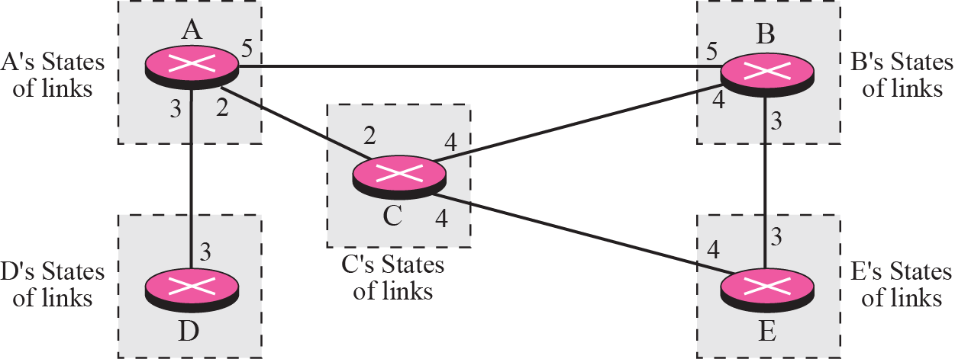
Figure 11.18 Link state knowledge
Figure, indicating the part of the knowledge belonging to each node.

Slide 59
Building Routing Tables
four sets of actions in link state routing
Creation of states of the links by each node, called link state packet (LSP).
Dissemination of LSPs to every other router, called flooding, in an efficient and reliable way.
Formation of a shortest path tree for each node.
Calculation of a routing table based on the shortest path tree.

Slide 60
1 Creation of Link State Packet (LSP)
A link state packet (LSP) can carry a large amount of information. Here, considered minimum data: the node identity, the list of links, a sequence number, and age.
node identity and the list of links, are needed to make the topology.
sequence number, facilitates flooding and distinguishes new LSPs from old ones.
age, prevents old LSPs from remaining in the domain for a long time.

Slide 61
1 Creation of Link State Packet (LSP) (contd)
LSPs are generated on two occasions:
When there is a change in the topology of the domain.
On a periodic basis. The period in this case is much longer compared to distance vector routing. It is done to ensure that old information is removed from the domain. The timer set for 60 minutes or 2 hours based on the implementation. A longer period ensures that flooding does not create too much traffic on the network.

Slide 62
2 Flooding of LSPs
LSP is disseminated to all other nodes, not only to its neighbors. The process is called flooding and based on the following:
The creating node sends a copy of the LSP out of each interface.
2. A node that receives an LSP compares it with the copy it may already have. If the newly arrived LSP is older than the one it has (by checking sequence number), it discards the LSP. If it is newer, the node does the following:
It discards the old LSP and keeps the new one.
It sends a copy of it out of each interface except the one from which the packet arrived.

Slide 63
3 Formation of Shortest Path Tree: Dijkstra Algorithm
After receiving all LSPs, each node will have a copy of the whole topology.
To find shortest path to every other node; a shortest path tree is needed.
A tree is a graph of nodes and links; one node is called the root.
A shortest path tree is a tree in which the path between the root and every other node is the shortest.
Dijkstra algorithm is used to create a shortest path tree from a given graph.

Slide 64
Formation of Shortest Path Tree: Dijkstra Algorithm (contd)
The algorithm uses the following steps:
Initialization: Select the node as the root of the tree and add it to the path. Set the shortest distances for all the root’s neighbors to the cost between the root and those neighbors. Set the shortest distance of the root to zero.
2. Iteration: Repeat the below two steps until all nodes are added to the path:
Adding the next node to the path: Search the nodes not in the path. Select the one with minimum shortest distance and add it to the path.
Updating: Update the shortest distance for all remaining nodes using the shortest distance of the node just moved to the path in step 2.

Slide 65
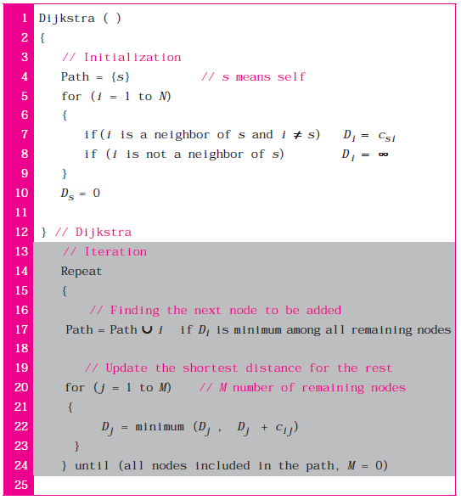
Formation of Shortest Path Tree: Dijkstra Algorithm (contd)

Slide 66
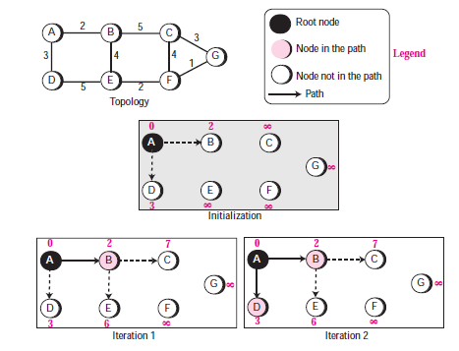
Formation of Shortest Path Tree: Dijkstra Algorithm (contd)

Slide 67
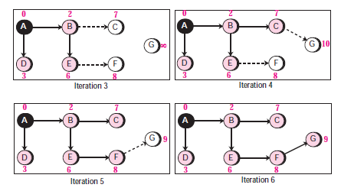
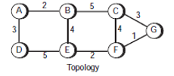
Formation of Shortest Path Tree: Dijkstra Algorithm (contd)

Slide 68
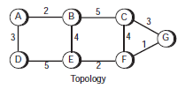
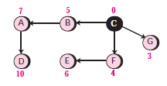
Formation of Shortest Path Tree: Dijkstra Algorithm (contd)
Shortest path tree for each node is different.
The shortest path tree as seen by node C is.

Slide 69


4 Calculation of Routing Table from Shortest Path Tree
Each node uses the shortest path tree found to construct its routing table.
The routing table shows the cost of reaching each node from the root.
Table 11.4 shows the routing table for node A.

Slide 70
11-6 OSPF
Open Shortest Path First (OSPF) protocol is an intra-domain routing protocol based on link state routing.
Its domain is also an autonomous system.

Slide 71
Areas
To handle routing efficiently, OSPF divides an autonomous system into areas.
An area is a collection of networks, hosts, and routers all contained within an autonomous system.
Routers inside an area flood the area with routing information.
At the border of an area, special routers called area border routers summarize the information about the area and send it to other areas.

Slide 72
Areas
Among the areas inside an autonomous system is a special area called the backbone;
All of the areas inside an autonomous system must be connected to the backbone.
The backbone serves as a primary area and the other areas as secondary areas.
The routers inside the backbone are called the backbone routers. Backbone router can also be an area border router.
If, because of some problem, the connectivity between a backbone and an area is
broken, a virtual link between routers must be created by the administration.
Each area has an area identification. The area identification of the backbone is zero.

Slide 73

Figure 11.21 Areas in an autonomous system

Slide 74
Metric
The OSPF protocol allows the administrator to assign a cost, called the metric, to each route.
The metric can be based on a type of service (minimum delay, maximum throughput, and so on).
Router can have multiple routing tables, each based on a different type of service.

Slide 75

Figure 11.22 Types of links
Types of Links
In OSPF terminology, a connection is called a link.
Four types of links have been defined:

Slide 76


Point-to-Point Link
A point-to-point link connects two routers without any other host or router in
between.
The purpose of the link (network) is just to connect the two routers.
Example : Two routers connected by a telephone line. There is no need to assign a network address to this type of link.
Graphically, routers are represented by nodes, and link is represented by a edge connecting nodes.
Each router has only one neighbor at the other side of the link.

Slide 77


Transient Link
A transient link is a network with several routers attached to it.
The data can enter through any of the routers and leave through any router.
All LANs and some WANs with two or more routers are of this type.
Each router has many neighbors.
To show the neighborhood relationship, we have the graph shown in Figure b.

Slide 78
Transient Link
This is neither efficient nor realistic.
It is not efficient because each router needs to advertise the neighborhood to four other routers, for a total of 20 advertisements.
It is not realistic, because there is no single network (link) between each pair of routers;

Slide 79

Transient Link
To show that each router is connected to every other router through one single network, the network itself is represented by a node.
However, because a network is not a machine, it cannot function as a router.
One of the routers in the network takes this responsibility.
It is assigned a dual purpose; it is a true router and a designated router.
Topology shown in Figure c to show the connections of a transient network.
Now each router has only one neighbor, the designated router (network).
The designated router (the network) has five neighbors. The number of neighbor announcements is reduced from 20 to 10.

Slide 80


Stub Link
A stub link is a network that is connected to only one router.
Data packets enter the network through this single router and leave the network through this same router.
This is a special case of the transient network.

Slide 81
Virtual Link
When the link between two routers is broken, the administration may create a virtual link between them using a longer path that probably goes through several routers.

Slide 82


Figure 11.26 Example of an AS and its graphical representation in OSPF
Graphical Representation

Slide 83
Graphical Representation
Two of the networks are point-to-point networks.
N1 and N2 represents transient and stub networks.
There is no need to assign an identity to a point-to-point network.
The figure also shows the graphical representation of the AS as seen by OSPF.
Color nodes for the routers and shaded nodes for the networks (represented by designated routers).
OSPF sees both as nodes.

Slide 84


OSPF packet
OSPF uses five different types of packets.
Most important one is the link state update that itself has five different kinds.

Slide 85

Figure 11.28 OSPF common header
OSPF Common Header
Version. Defines the version of the OSPF protocol. It is currently version 2.
Type. Defines the type of the packet. five types, with values 1 to 5.
Message length. Defines the length of the total message including the header.
Source router IP address. IP address of router that sends the packet.
Area identification. Defines the area within which the routing takes place.
Checksum. Used for error detection on the entire packet excluding the authentication type and authentication data field.
Authentication type. Two types of authentication are defined: 0 for none and 1 for password.
Authentication. If the authentication type is 0, this field is filled with 0s. If the type is 1, this field carries an eight-character password.

Slide 86

Link state update packet is the heart of the OSPF operation. It is used by a router to advertise the states of its links.
Link state update packet

Slide 87

Figure 11.30 LSA general header
Each update packet may contain several different LSAs. All five kinds have the same general header.
Link state age.
Indicates the number of seconds elapsed since this message was first generated.
When a router creates the message, the value of this field is 0.
When each successive router forwards this message, it estimates the transit time and adds it to the cumulative value of this field.
E flag. If this 1-bit flag is set to 1, it means the area is a stub area.
T flag. If this 1-bit flag is set to 1, it means router can handle multiple types of service.
Link state type. Five different types: router link (1), network link (2), summary link to network (3), summary link to AS boundary router (4), and external link (5).

Slide 88
Figure 11.30 LSA general header
Link state ID. The value of this field depends on the type of link.
For type 1 (router link), it is the IP address of the router.
For type 2 (network link), it is the IP address of the designated router.
For type 3 (summary link to network), it is the address of the network.
type 4 (summary link to AS boundary router), it is the IP address of the AS boundary router.
For type 5 (external link), it is the address of the external network.
Advertising router. IP address of the router advertising this message.
Link state sequence number. sequence number assigned to each link state update message.
Link state checksum. Value of this field is calculated using Fletcher’s checksum , which is based on the whole packet except for the age field.
Length. Defines the length of the whole packet in bytes.

Slide 89

Figure 11.31 Router link
Router Link LSA
A router link defines the links of a true router.
A true router uses this advertisement to announce information about all of its links and what is at the other side of the link (neighbors).
The router link LSA advertises all of the links of a router (true router).

Slide 90


Figure 11.32 Router link LSA
Format of the router link packet
The fields of the router link LSA are:
Link type. Four different types of links (Table 11.5).
Link ID. The value of this field depends on the type of link (Table 11.5)
Link data. Gives additional information about the link. Value depends on type of link (Table 11.5).
Number of types of service (TOS). Defines the number of types of services announced for each link.
Metric for TOS 0. Defines the metric for the default type of service (TOS 0).
TOS. This field defines the type of service.
Metric. Defines the metric for the corresponding TOS.

Slide 91

Example 11.7
Give the router link LSA sent by router 10.24.7.9

Slide 92

Figure 11.34 Solution to Example 11.7
Router has 3 links: two of type 1 (point-to-point) and one of type 3 (stub network).

Slide 93

Figure 11.35 Network link
Network Link LSA
A network link defines the links of a network. A designated router, on behalf of the transient network, distributes this type of LSP packet.
Packet announces the existence of all of the routers connected to the network.

Slide 94

Figure 11.36 Network link advertisement format
The format of the network link advertisement is.
Network mask. This field defines the network mask.
Attached router. This repeated field defines the IP addresses of all attached routers.

Slide 95

Example 11.8
Give the network link LSA in Figure 11.37.

Slide 96

Figure 11.38 Solution to Example 11.8
Solution
Network for which the network link advertises has three routers attached. The LSA shows the mask and the router addresses.

Slide 97

Example 11.9
In Figure 11.39, which router(s) sends out router link LSAs?

Slide 98
Example 11.9
In Figure 11.39, which router(s) sends out router link LSAs?
Solution
All routers advertise router link LSAs.
a. R1 has two links, N1 and N2.
b. R2 has one link, N2.
c. R3 has two links, N2 and N3.

Slide 99
Example 11.10
In Figure 11.39, which router(s) sends out the network link LSAs?
Solution
All three networks must advertise network links:
a. Advertisement for N1 is done by R1 because it is the only attached router and therefore the designated router.
b. Advertisement for N2 can be done by either R1, R2, or R3, depending on which one is chosen as the designated router.
c. Advertisement for N3 is done by R3 because it is the only attached router and therefore the designated router

Slide 100

Summary Link to Network LSA
The summary link to network LSA is used by the area border router to announce the existence of other networks outside the area.
An area border router is active in more than one area. It receives router link and network link advertisements, and, creates a routing table for each area.
Router R1 is an area border router. It has 2 routing tables, one for area 1 and one for area 0.
R1 floods area 1 with information about how to reach a network located in area 0.
R2 floods area 2 with information about how to reach the same network in area 0.

Slide 101

Figure 11.41 Summary link to network LSA
The fields of the summary link to network LSA are :
Each advertisement announces only one single network. If there is more than one network, a separate advertisement must be issued for each.
IP address of advertising router is present in the header of the link state advertisement. From this information and the mask, one can deduce the network address.
Network mask. This field defines the network mask.
TOS. This field defines the type of service.
Metric. This field defines the metric for the type of service defined in the TOS field.

Slide 102

Summary Link to AS Boundary Router LSA
If a router inside an area wants to send a packet outside the autonomous system, it should first know the route to an autonomous boundary router;
The summary link to AS boundary router LSA provides this information.
The area border routers flood their areas with this information.
This packet is used to announce the route to an AS boundary router. Its format is the same as the previous summary link.

Slide 103

Figure 11.43 Summary link to AS boundary router LSA
The fields are the same as the fields in the summary link to network advertisement message.

Slide 104

External Link LSA
A router inside an autonomous system wants to know which networks are available outside the autonomous system; External link advertisement provides this information.
AS boundary router floods the autonomous system with the cost of each network outside the autonomous system using a routing table created by an interdomain routing protocol.
Each advertisement announces one single network. If there is more than one network, separate announcements are made.

Slide 105

Figure 11.45 External link LSA
The format of the LSA is similar to the summary link to the AS boundary router LSA, with the addition of two fields.

Slide 106
Other Packets
Four other packet types. These are not used as LSAs, but are essential to the operation of OSPF.
Hello Message
OSPF uses the hello message to create neighborhood relationships and to test the reachability of neighbors.
This is the first step in link state routing.
Before a router can flood all of the other routers with information about its neighbors, it must first greet its neighbors.
It must know if they are alive, and it must know if they are reachable.

Slide 107

Figure 11.46 Hello packet
*Network mask. 32-bit field defines the network mask of the network over which the hello message is sent.
*Hello interval. 16-bit field defines the number of seconds between hello messages.
*E flag. This is a 1-bit flag. When it is set, it means that the area is a stub area.
T flag. 1-bit flag. When it is set, it means that the router supports multiple metrics.

Slide 108
Figure 11.46 Hello packet
Priority. Defines the priority of the router. Priority determines the selection of the designated router. After all neighbors declare their priorities, the router with the highest priority is chosen as the designated router. The one with the second highest priority is chosen as the backup designated router. If the value of this field is 0, it means that the router never wants to be a designated or a backup designated router.
*Dead interval. 32-bit field defines the number of seconds that must pass before a router assumes that a neighbor is dead.
Designated router IP address. 32-bit field is the IP address of the designated router for the network over which the message is sent.
Backup designated router IP address. 32-bit field is the IP address of the backup designated router for the network over which the message is sent.
Neighbor IP address. This is a repeated 32-bit field that defines the routers that have agreed to be the neighbors of the sending router. In other words, it is a current list of all the neighbors from which the sending router has received the hello message.

Slide 109
Figure 11.47 Database description packet
Database Description Message
When a router is connected to the system, it sends hello packets to greet its neighbors.
If this is the first time that the neighbors hear from the router, they send a database description message.
The database description packet does not contain complete database information;
It only gives an outline, the title of each line in the database. The newly connected router examines the outline and finds out which lines of information it does not have.
It then sends one or more link state request packets to get full information about that particular link.
When two routers want to exchange database description packets, one of them takes the role of master and the other the role of slave. Because the message can be very long, the contents of the database can be divided into several messages.

Slide 110

Figure 11.47 Database description packet
E flag. This 1-bit flag is set to 1 if the advertising router is an autonomous boundary router (E stands for external).
B flag. This 1-bit flag is set to 1 if the advertising router is an area border router.
I flag. This 1-bit field, the initialization flag, is set to 1 if the message is the first message.
M flag. This 1-bit field, the more flag, is set to 1 if this is not the last message.
M/S flag. This 1-bit field, the master/slave bit, indicates the origin of the packet:
master (M/S = 1) or slave (M/S = 0).
Message sequence number. 32-bit field contains the sequence number of the message. Used to match a request with the response.
LSA header. 20-byte field is used in each LSA. (format of header is presented link state update message section.) This header gives the outline of each link, without details.

Slide 111

Figure 11.48 Link state request packet
Link State Request Packet
This is a packet that is sent by a router that needs information about a specific route or routes. It is answered with a link state update packet.
It can be used by a newly connected router to request more information about some routes after receiving the database description packet.
The three fields here are part of the LSA header.
Each set of the three fields is a request for one single LSA. The set is repeated if more than one advertisement is desired.

Slide 112

Figure 11.49 Link state acknowledgment packet
Link State Acknowledgment Packet
The format of the link state acknowledgment packet is.
It has the common OSPF header and the general LSA header.
These two sections are sufficient to acknowledge a packet.

Slide 113
Encapsulation
OSPF packets are encapsulated in IP datagrams.
They contain the acknowledgment mechanism for flow and error control.
They do not need a transport layer protocol to provide these services.

Slide 114
OSPF packet
OSPF uses five different types of packets.
Most important one is the link state update that itself has five different kinds.

Slide 115
11-7 PATH VECTOR ROUTING
Both Distance vector and link state routing become intractable when the domain of operation becomes large.
Distance vector routing is subject to instability if there is more than a few hops in the domain of operation.
Link state routing needs a huge amount of resources to calculate routing tables. It also creates heavy traffic because of flooding.

Slide 116
Path vector routing is exterior routing protocol for interdomain (inter-AS) routing.
In distance vector routing, a router has a list of networks that can be reached in the same AS with the corresponding cost (number of hops).
In path vector routing, a router has a list of networks that can be reached with the path (list of ASs to pass) to reach each one.

Slide 117
Reachability
To be able to provide information to other ASs, each AS must have at least one path vector routing that collects reachability information about each network in that AS.
Figure shows three ASs. Each router has created a list which shows which network is reachable in that AS.

Slide 118




Figure 11.50 Reachability

Slide 119



Figure 11.51 Stabilized table for three autonomous system
Routing Tables
A path vector routing table for each router can be created if ASs share their reachability list with each other.
Figure shows routing table for each router after all 3 routers have updated their routing table.

Slide 120
Figure 11.51 Stabilized table for three autonomous system
Routing Tables (contd)
Router R1 knows that if a packet arrives for the network 201.2.2.0/24, this network is in AS1 (at home),
If a packet arrives for the network 130.14.0.0/16, the packet should travel from AS1 to AS2 to reach its destination network.

Slide 121
Loop Prevention
The instability of distance vector routing and the creation of loops can be avoided in path vector routing.
When a router receives a reachability information, it checks to see if its autonomous system is in the path list to any destination.
If it is, looping is involved and that network-path pair is discarded.

Slide 122



Aggregation
The path vector routing protocols support CIDR notation and the aggregation of addresses (if possible).
This helps to make the path vector routing table simpler and exchange between routers faster.
Path vector routing table of Figure 11.51 can be aggregated to create shorter routing tables (Figure 11.52).

Slide 123
Aggregation
Range may also include a block that may not be in the corresponding AS.
For example, the range 201.2.0.0/22 also includes the range 201.2.0.3/24, which is not the network address of any network in AS1.
However, if this network exists in some other ASs, it eventually becomes part of the routing table ( Based on the longest prefix principle)

Slide 124
Policy Routing
Policy routing can be implemented through path vector routing.
When a router receives a message, it can check the path.
If one of the autonomous systems listed in the path is against its policy, it can ignore that path and that destination.

Slide 125
11-8 BGP
Border Gateway Protocol (BGP) is an interdomain routing protocol using path vector routing.
It first appeared in 1989 and has gone through four versions.

Slide 126
Types of Autonomous Systems
Internet is divided into hierarchical domains called autonomous systems (ASs).
For example, a large corporation that manages its own network and has full control over it is an autonomous system.
A local ISP that provides services to local customers is an autonomous system.
We can divide autonomous systems into three categories: stub, multihomed, and transit.

Slide 127
Stub AS
A stub AS has only one connection to another AS.
Interdomain data traffic in a stub AS can be either created or terminated in the AS.
The hosts in the AS can send data traffic to other ASs.
The hosts in the AS can receive data coming from hosts in other ASs.
Data traffic, however, cannot pass through a stub AS.
A stub AS is either a source or a sink.
A good example of a stub AS is a small corporation or a small local ISP.

Slide 128
Multihomed AS
A multihomed AS has more than one connection to other ASs, but it is still only a source or sink for data traffic.
It can receive data traffic from more than one AS.
It can send data traffic to more than one AS.
It does not allow data coming from one AS and going to another AS to pass through.
Example of a multihomed AS is a large corporation that is connected to more than one regional or national AS.

Slide 129
Transit AS
A transit AS is a multihomed AS that also allows transient traffic.
Examples of transit ASs are national and international ISPs (Internet backbones).

Slide 130
CIDR
BGP uses classless interdomain routing addresses.
BGP uses a prefix, to define a destination address.
The address and the number of bits (prefix length) are used in updating messages

Slide 131
Path Attributes
Previous example, presented the path for a destination network.
The path was presented as a list of autonomous systems, but is, a list of attributes.
Each attribute gives some information about the path.
List of attributes helps receiving router make a better decision when applying its policy.
Attributes are divided into two broad categories: well-known and optional.
A wellknown attribute is one that every BGP router must recognize.
An optional attribute is one that needs not be recognized by every router.

Slide 132
Path Attributes (contd)
Well-known attributes are divided into two categories: mandatory and discretionary.
A well-known mandatory attribute is one that must appear in the description of a route.
A well-known discretionary attribute is one that must be recognized by each router, but is not required to be included in every update message.
One well-known mandatory attribute is ORIGIN. This defines the source of the routing information (RIP, OSPF, and so on).
Another well-known mandatory attribute is AS_PATH. This defines the list of autonomous systems through which the destination can be reached.
Another well-known mandatory attribute is NEXT-HOP, which defines the nextrouter to which the data packet should be sent.

Slide 133
Path Attributes (contd)
The optional attributes can also be subdivided into two categories: transitive and nontransitive.
An optional transitive attribute is one that must be passed to the next router by the router that has not implemented this attribute.
An optional nontransitive attribute is one that must be discarded if the receiving router has not implemented it.

Slide 134
BGP Sessions
The exchange of routing information between two routers using BGP takes place in a session.
A session is a connection that is established between two BGP routers only for
the sake of exchanging routing information.
To create a reliable environment, BGP uses the services of TCP.

Slide 135
External and Internal BGP
BGP can have two types of sessions: external BGP (E-BGP) and internal BGP (I-BGP) sessions.
E-BGP session is used to exchange information between two speaker nodes belonging to two different autonomous systems.
I-BGP session, is used to exchange routing information between two routers inside an autonomous system.

Slide 136


Figure 11.53 Internal and external BGP sessions
The session established between AS1 and AS2 is an E-BGP session.
The two speaker routers exchange information they know about networks in the Internet.
These two routers need to collect information from other routers in the autonomous systems. This is done using I-BGP sessions.

Slide 137

Figure 11.54 Types of BGP messages
Types of Packets
BGP uses four different types of messages

Slide 138

Figure 11.55 BGP packet header
Packet Format
All BGP packets share the same common header. The fields of this header are:
Marker. 16-byte marker field is reserved for authentication.
Length.2-byte field defines the length of the total message including the header.
Type. 1-byte field defines the type of the packet. Four types, and the values 1 to 4.

Slide 139

Figure 11.56 Open message
Open Message
To create a neighborhood relationship, a router running BGP opens a TCP connection with a neighbor and sends an open message.
If the neighbor accepts neighborhood relationship, it responds with a keepalive message, which means that a relationship has been established between the two routers.
The open message format :
Version. 1-byte field defines the version of BGP. The current version is 4.
My autonomous system. 2-byte field defines the autonomous system number.
Hold time. 2-byte field defines the maximum number of seconds that can elapse until one of the parties receives a keepalive or update message from the other. If a router does not receive one of these messages during the hold time period, it considers the other party dead.

Slide 140
Figure 11.56 Open message
BGP identifier. 4-byte field defines the router that sends the open message. The router uses one of its IP addresses for this purpose.
Option length. The open message may contain some option parameters. In this case, this 1-byte field defines the length of the total option parameters. If there are no option parameters, the value of this field is zero.
Option parameters. Each option parameter itself has two subfields: the length of the parameter and the parameter value. The only option parameter defined so far is authentication.

Slide 141

Figure 11.57 Update message
Update Message
The update message is the heart of the BGP protocol.
It is used by a router to withdraw destinations that have been advertised previously, announce a route to a new destination, or both.
BGP can withdraw several destinations that were advertised before, but it can only advertise one new destination in a single update message.
The format of the update message is :

Slide 142
Figure 11.57 Update message
Unfeasible routes length. 2-byte field defines the length of the next field.
Withdrawn routes. lists all the routes that must be deleted from the previously advertised list.
Path attributes length. 2-byte field defines the length of the next field.
Path attributes. This field defines the attributes of the path (route) to the network whose reachability is being announced in this message.
Network layer reachability information (NLRI). Defines the network that is actually advertised by this message. It has a length field and an IP address prefix. The length defines the number of bits in the prefix. The prefix defines the common part of the network address.
For example, if the network is 153.18.7.0/24, the length of the prefix is 24 and the prefix is 153.18.7.

Slide 143

Figure 11.58 Keepalive message
Keepalive Message
Routers running the BGP protocols exchange keepalive messages regularly (before their hold time expires) to tell each other that they are alive.
Keepalive message consists of only the common header shown below.

Slide 144

Figure 11.59 Notification message
Notification Message
A notification message is sent by a router whenever an error condition is detected or a router wants to close the connection.
The format of the message is :
Error code. This 1-byte field defines the category of the error (Table 11.6.)
Error subcode. This 1-byte field further defines the type of error in each category.
Error data. This field can be used to give more diagnostic information about the error.

Slide 145


Slide 146
Encapsulation
BGP messages are encapsulated in TCP segments using the well-known port 179.
This means that there is no need for error control and flow control.
When a TCP connection is opened, the exchange of update, keepalive, and notification messages is continued until a notification message of type cease is sent.

Slide 147
END

